Slide 1
Getting Started with Github
George Netscher

Slide 2
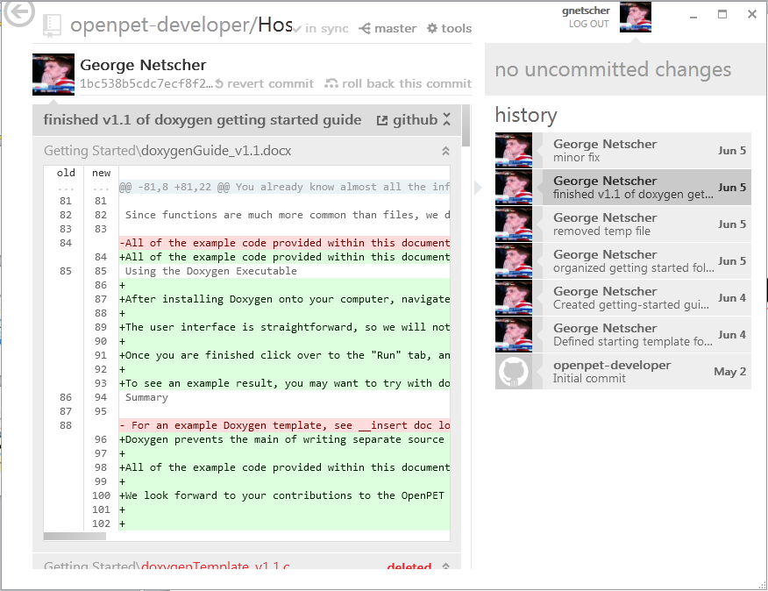
The goal

Slide 3
Setup and Installation

Slide 4
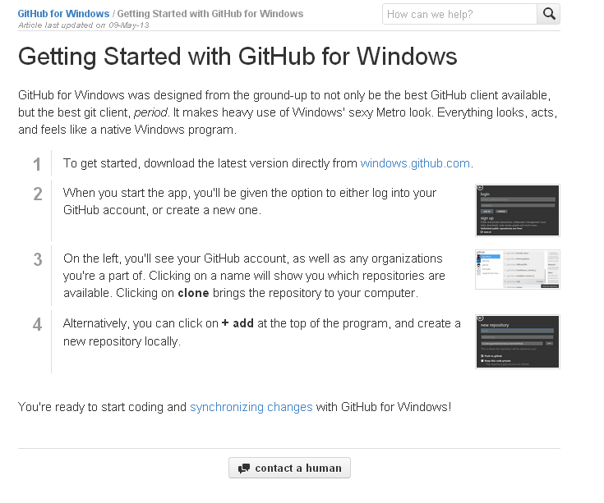

Slide 5
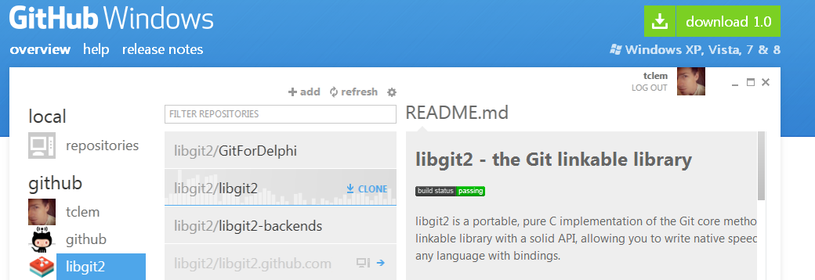

Slide 6
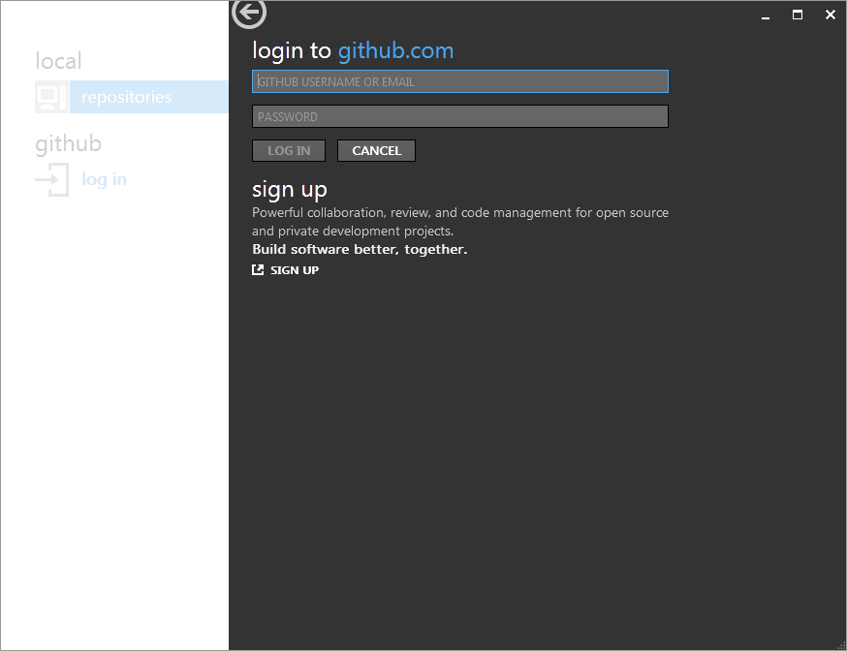

Slide 7
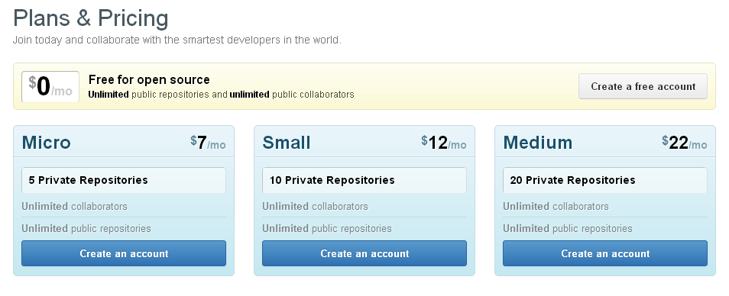

Slide 8
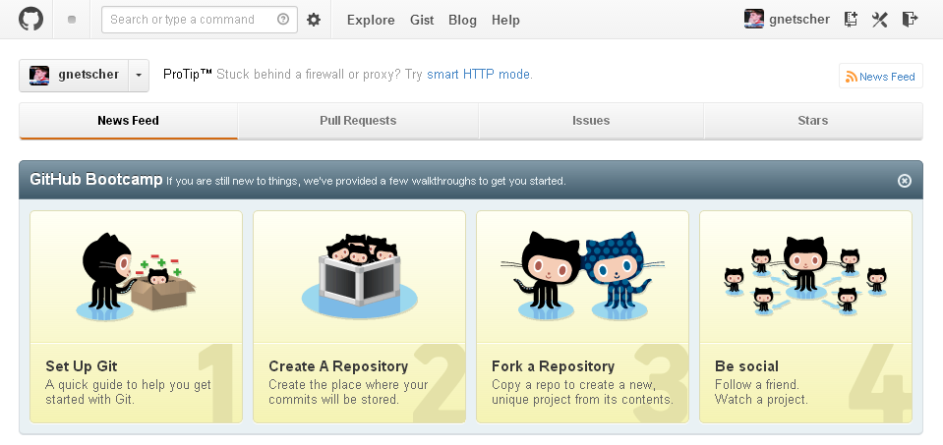

Slide 9
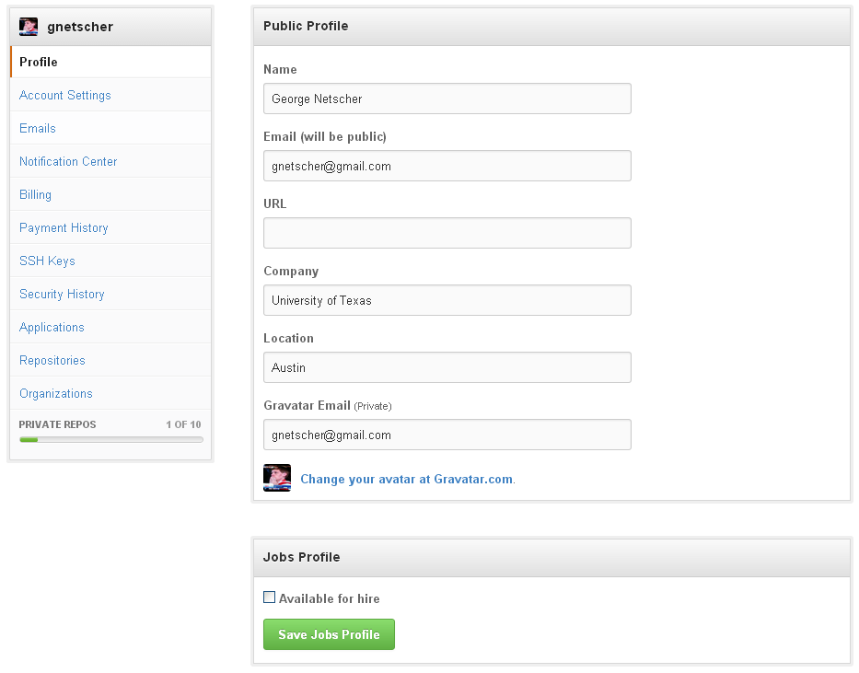

Slide 10
Cloning a Repository

Slide 11
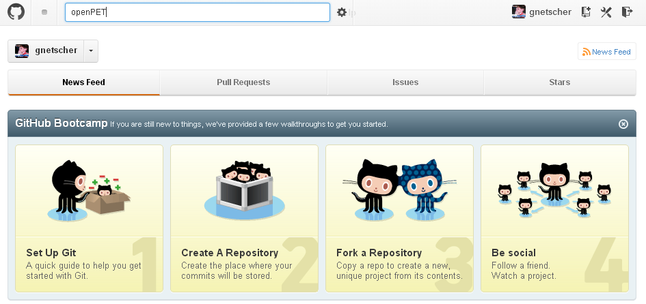

Slide 12
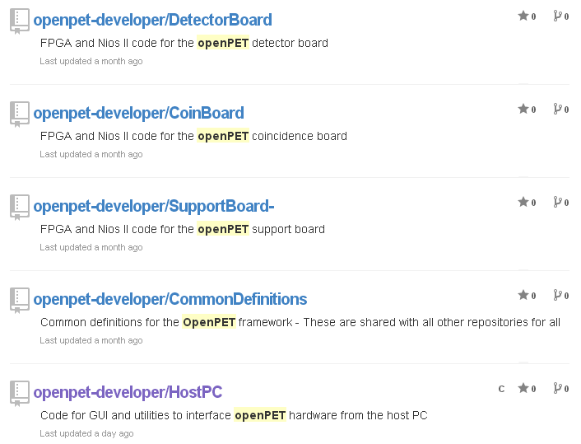
Owner grants collaborator permission
openpet-developer = Martin Judenhofer msjudenhofer@ucdavis.edu
Email with github username for permission

Slide 13
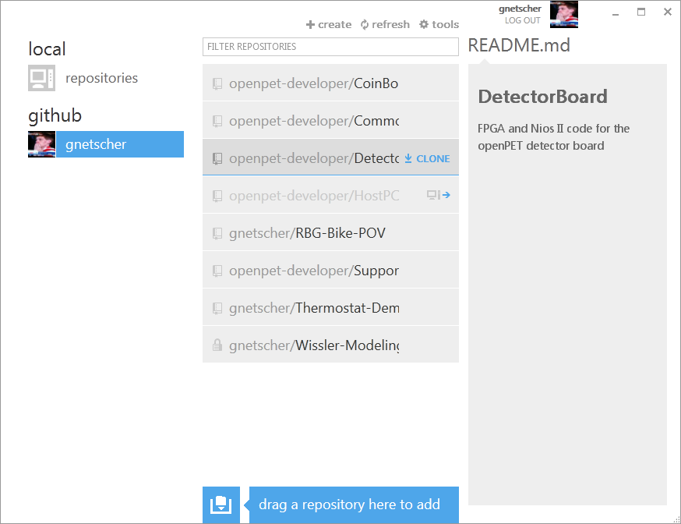

Slide 14
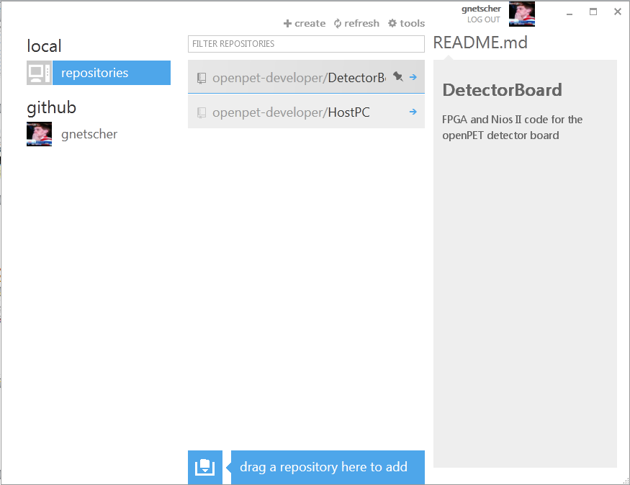

Slide 15
Making Changes

Slide 16
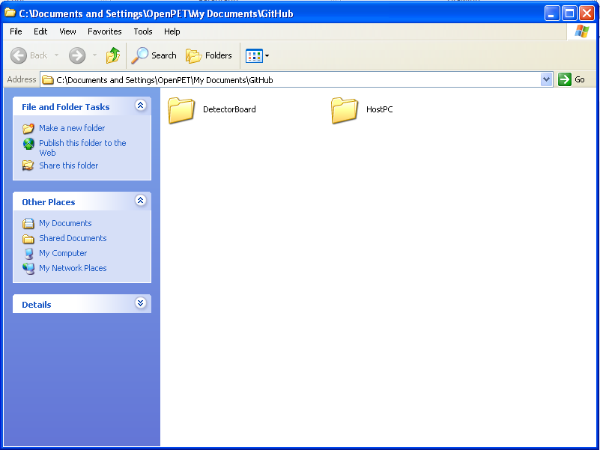
Create and edit documents
in your GitHub folder as you normally would

Slide 17
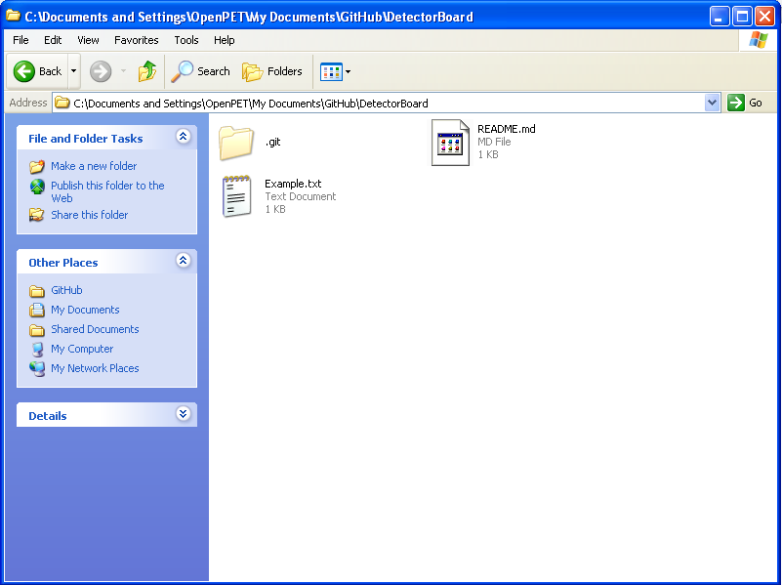

Slide 18
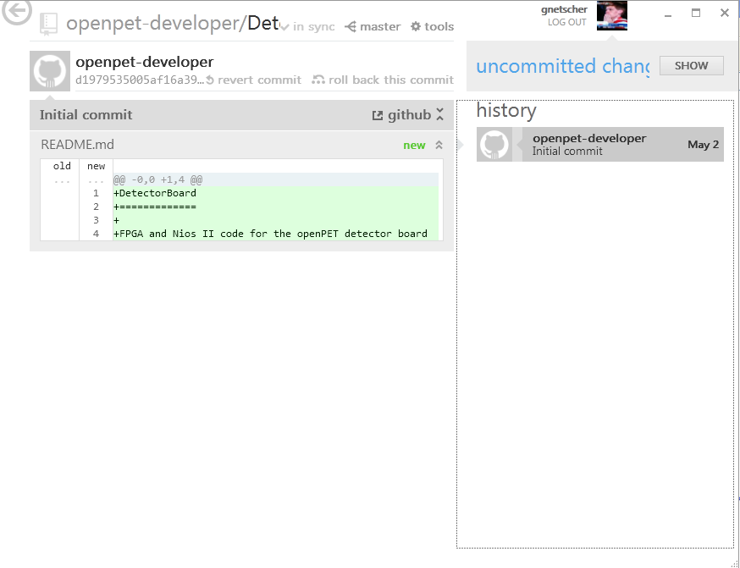

Slide 19
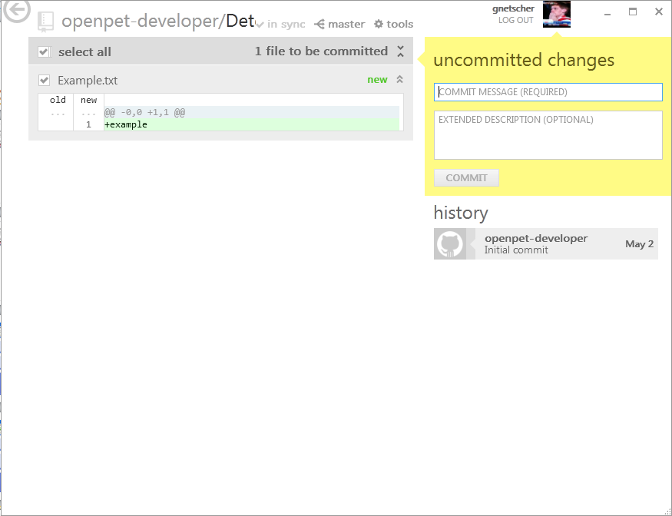

Slide 20
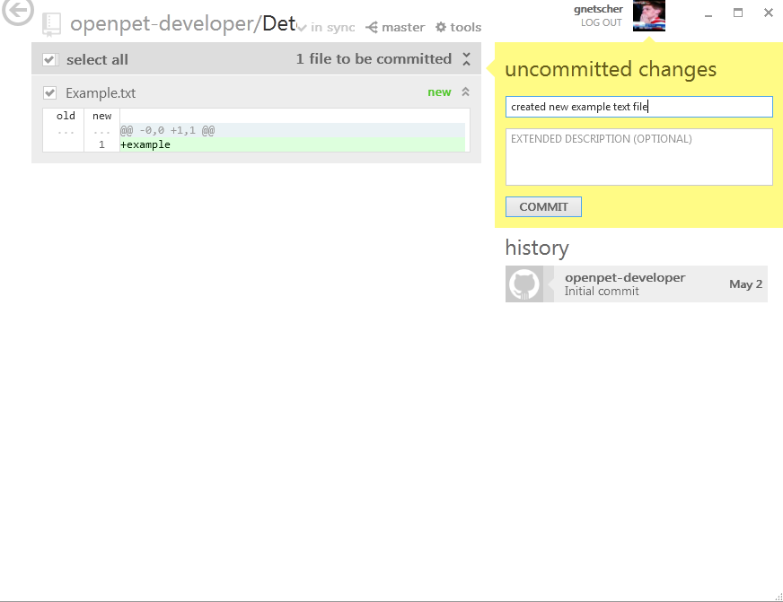

Slide 21
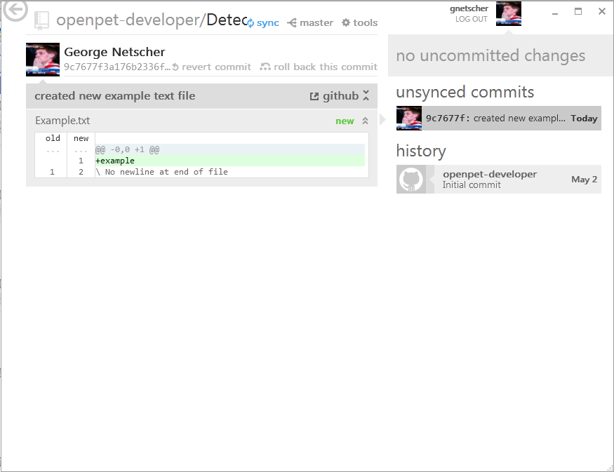

Slide 22
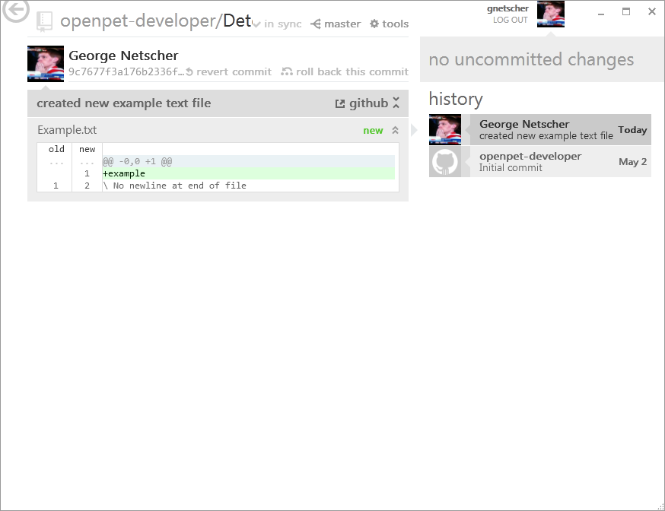
Local changes have now been pushed to public server

Slide 23
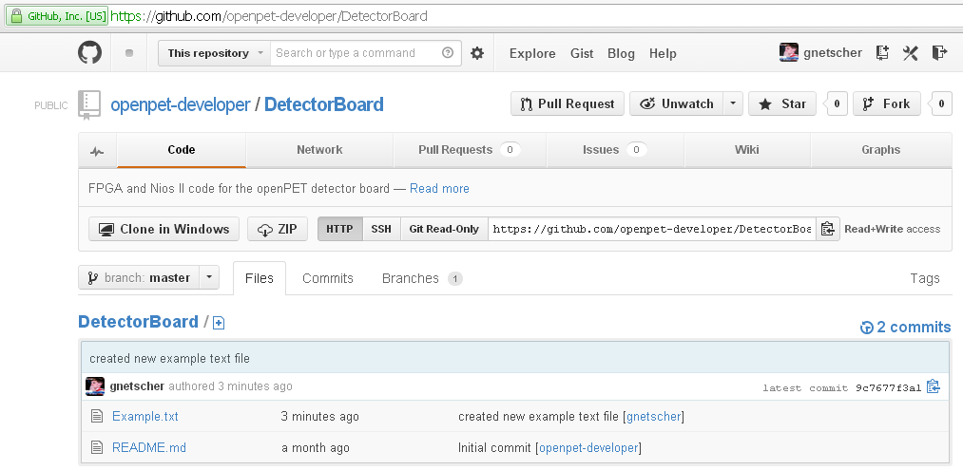
Online repository mirrors changes

Slide 24
Branching

Slide 25


Slide 26
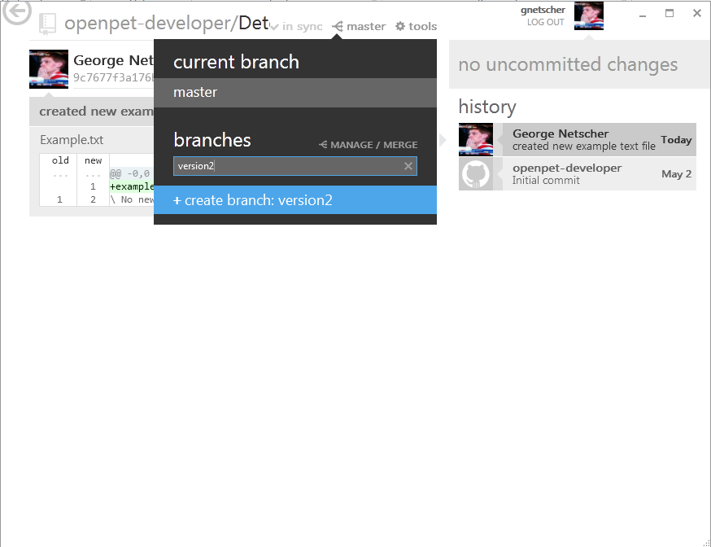

Slide 27


Slide 28
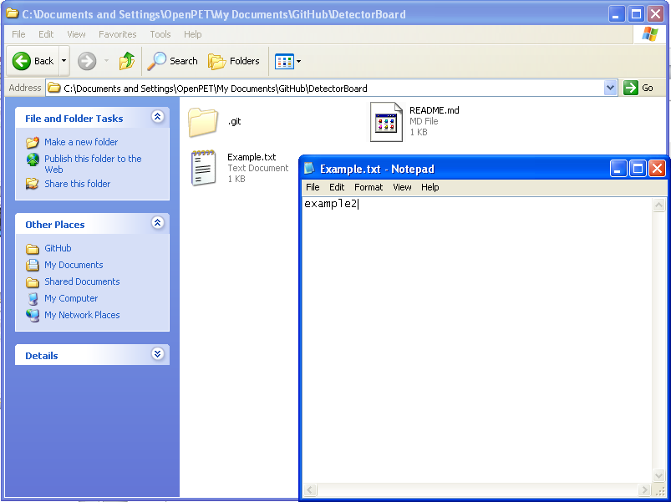

Slide 29
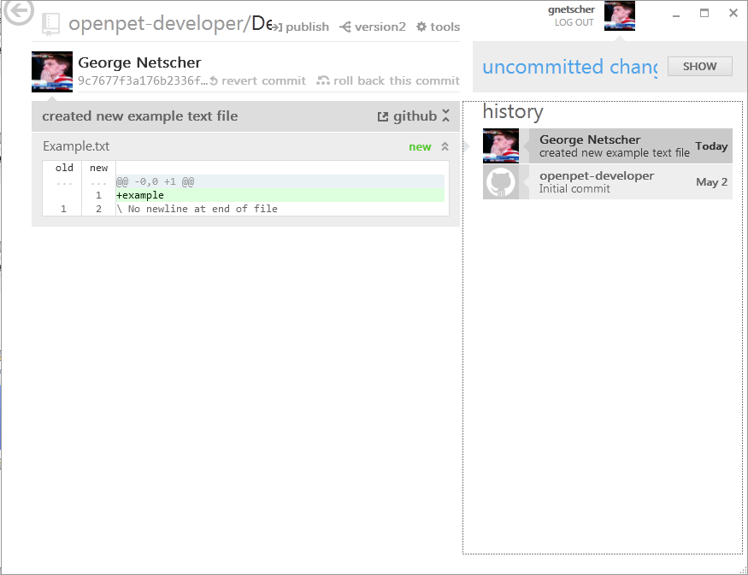

Slide 30
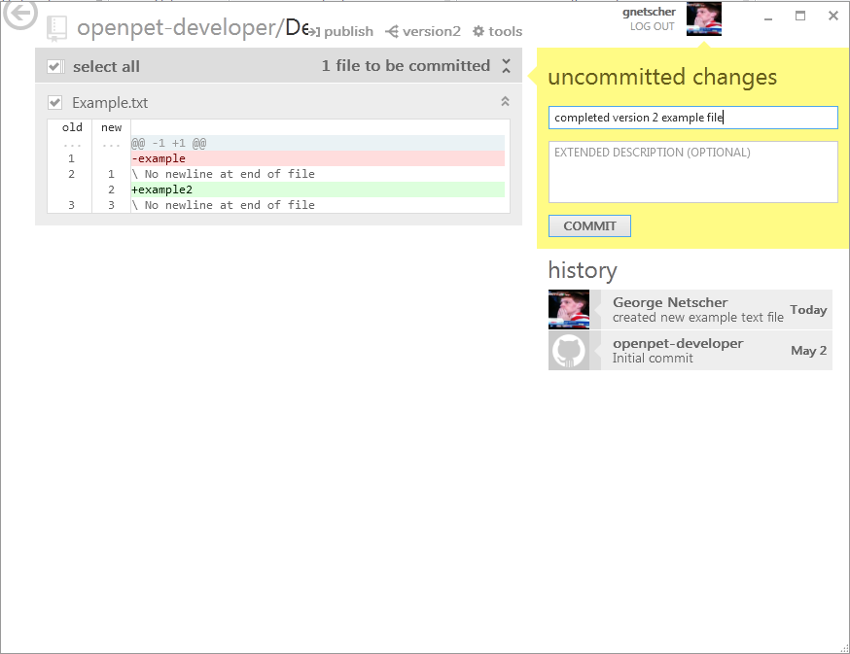

Slide 31
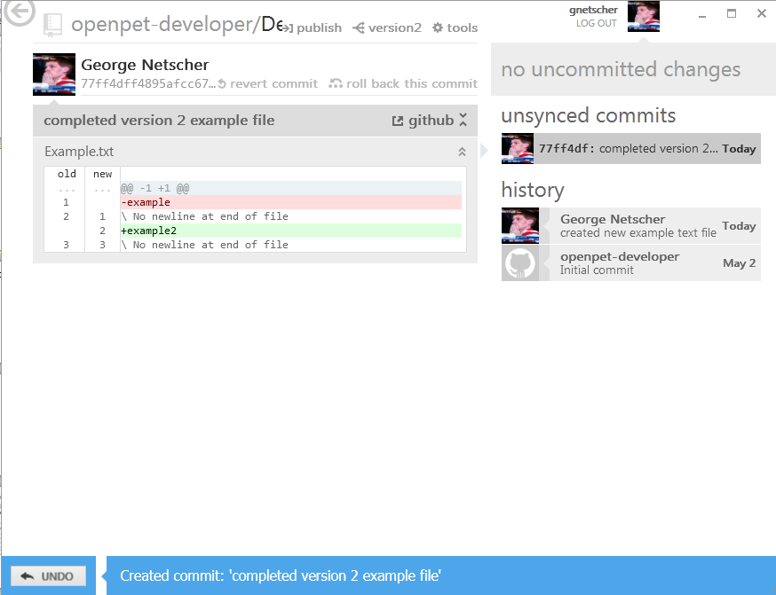

Slide 32
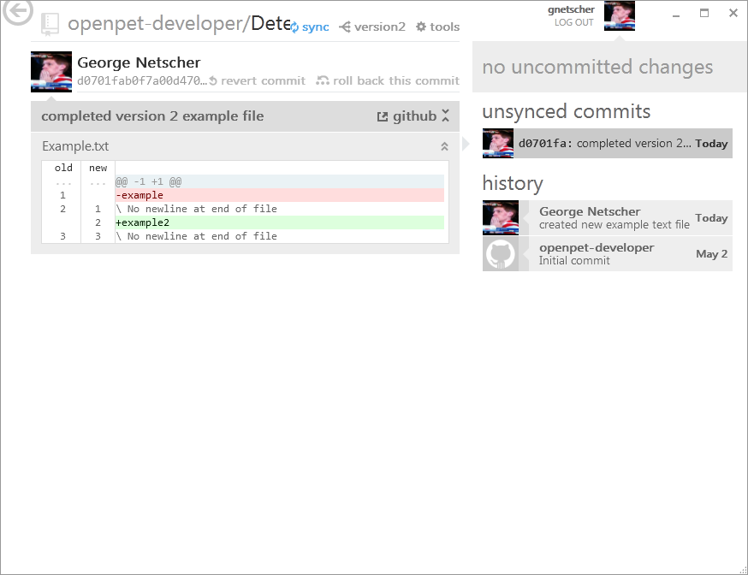

Slide 33
Merging

Slide 34
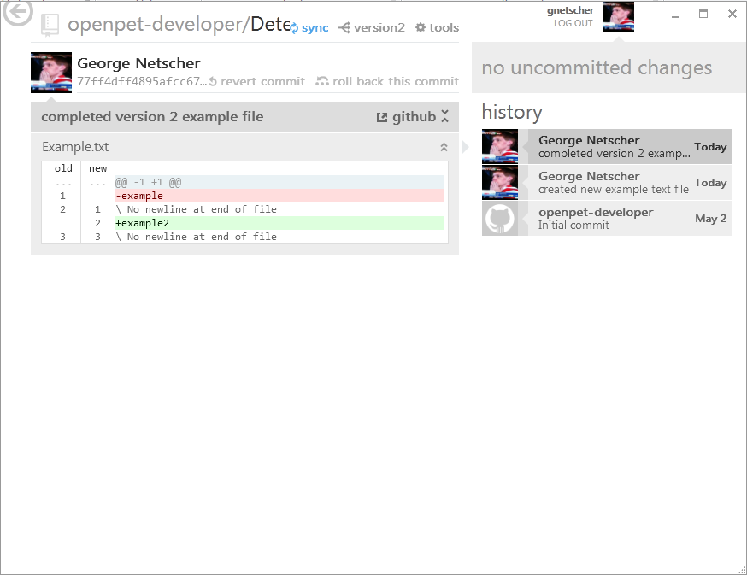

Slide 35
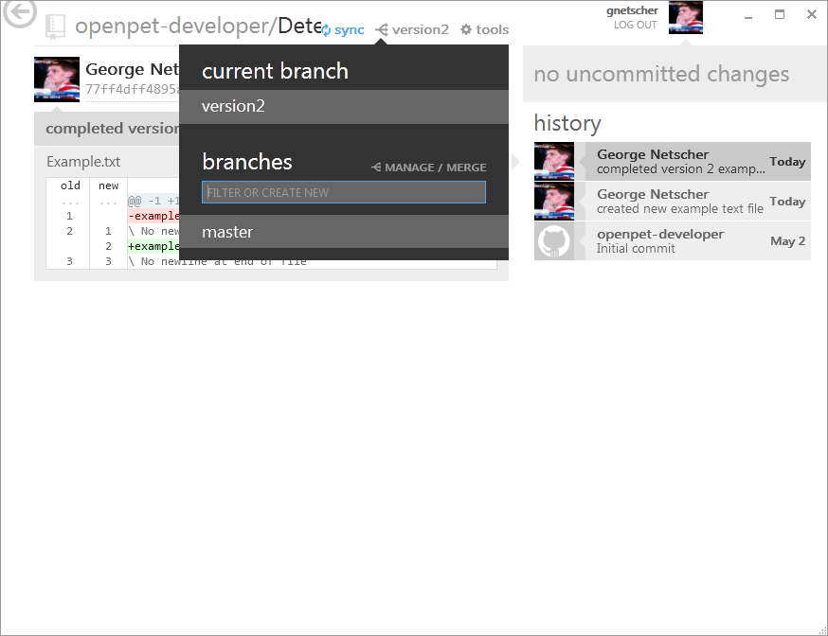

Slide 36
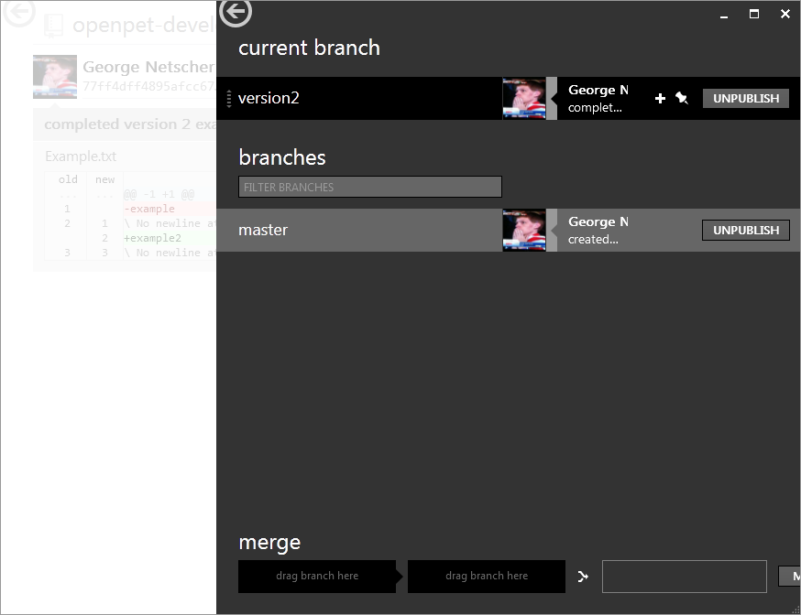

Slide 37
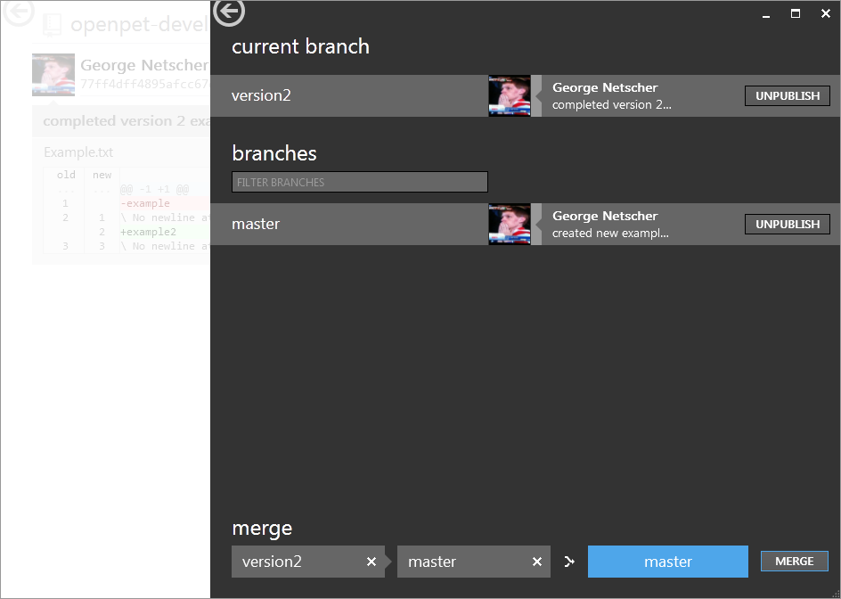
Updated files in this branch…
…will write over files in this one

Slide 38


Slide 39
Opensource Community Structure

Slide 40
Users
Collaborators
Owner/
Admin

Slide 41
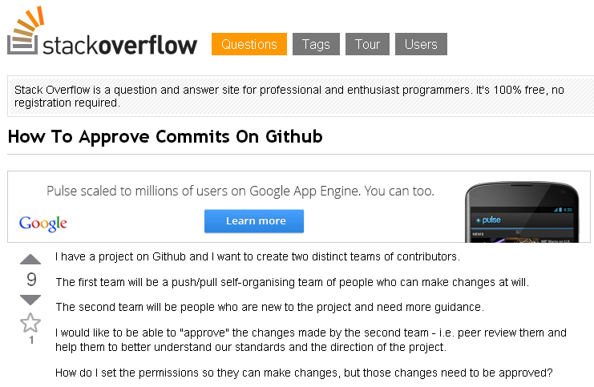
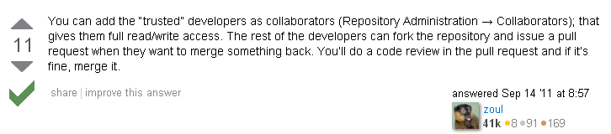

Slide 42
Summary
Clone – clones a repository into a local directory
Commit – groups changes to local files together with a brief description; preparation for sending back to public repository
Sync – pulls repository changes to existing local directory & pushes a commit or a group of commits to the public repository

Slide 43
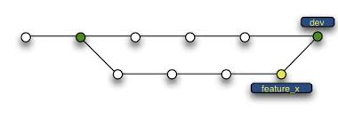
Summary
Branch – copies an existing repository into a new branch; usually to develop a new line of thought or work out a bug fix
Merge – combines two branches into one

